Slide 1
All About Decision Tree
Abu Bakar Siddique Mahi

Slide 2
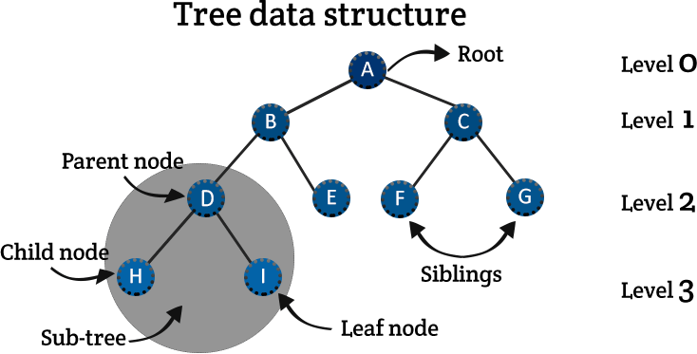
All about Decision Tree
A decision tree is a very specific type of probability tree that enables you to make a decision about some kind of process. It is used to break down complex problems or branches. Each branch of the decision tree could be a possible outcome.

Slide 3
A decision tree is a very specific type of probability tree that enables you to make a decision about some kind of process. It is used to break down complex problems or branches. Each branch of the decision tree could be a possible outcome.
Supervised
Classification
Entropy
Information Gain (IG)
Gini Index

Slide 4
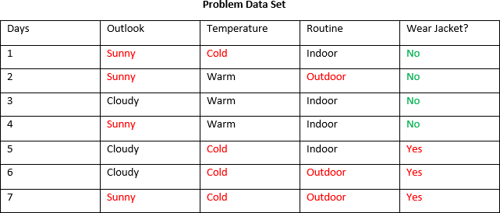
All about Decision Tree
Class

Slide 5
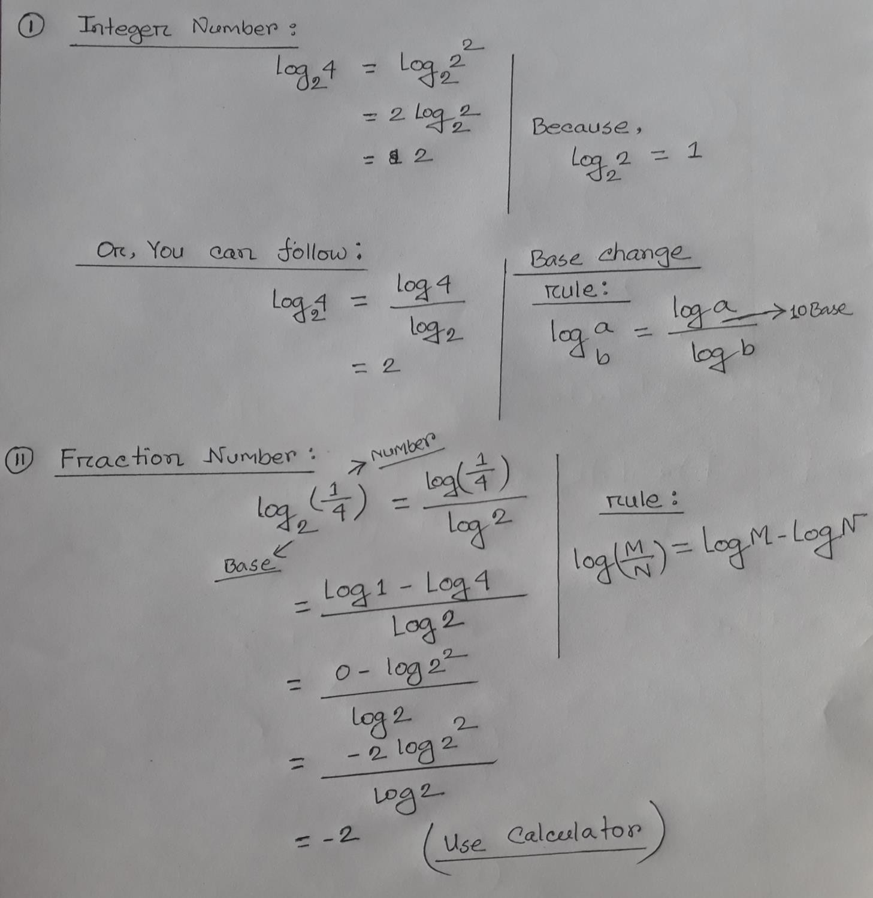


All about Decision Tree in Machine Learning

Slide 6

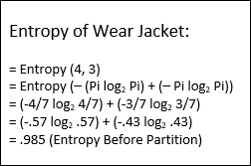
All about Decision Tree
Entropy Before Partition:
E(Y) = Entropy Before Partition E(Y|X) = Entropy After Partition Target, E(Y) >> E(Y|X)

Slide 7
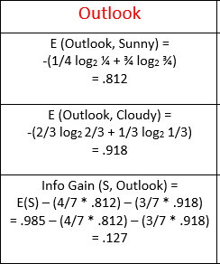
All about Decision Tree

Slide 8
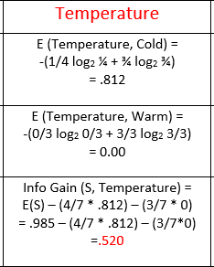
All about Decision Tree

Slide 9
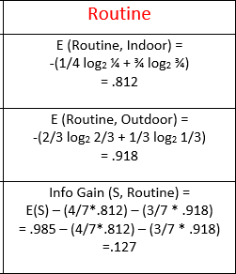
All about Decision Tree

Slide 10
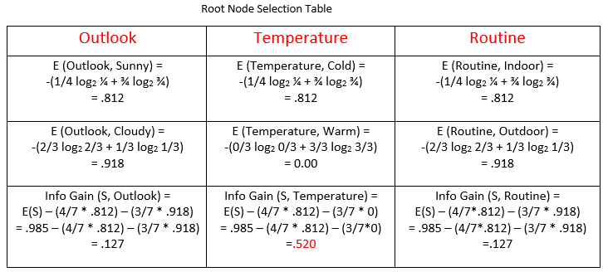
All about Decision Tree

Slide 11

All about Decision Tree
Root Node (Temperature)
Cold Yes(3), No(1)
(1,5,6,7)
Warm Yes(0), No(3)
(2,3,4)

Slide 12

All about Decision Tree
Root Node (Temperature)
Cold Yes(3), No(1)
(1,5,6,7)
Warm Yes(0), No(3)
(2,3,4)

Slide 13
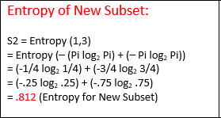
All about Decision Tree

Slide 14
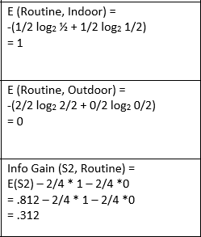
All about Decision Tree

Slide 15
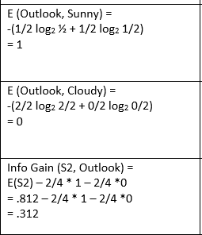
All about Decision Tree

Slide 16
All about Decision Tree
Temperature
Cold
Warm (No)
Routine
Indoor
Outdoor (Yes)
Sunny, Cold , Indoor= ??

Slide 17


All about Decision Tree
Outlook
no
yes
Sunny
Cloudy

Slide 18
All about Decision Tree
Temperature
Cold
Warm (No)
Routine
Indoor
Outdoor (Yes)
Outlook
Sunny, Cold , Indoor= ??
Sunny (No)
Cloudy (Yes)

